Slide 1
Robotic Seminar
Sensor Modeling in Sim2Real
Third meeting 18-Dec
Mingyuan Chi

Slide 2
RGB camera
Depth sensor
IMU
Force sensor
Encoders

Slide 3
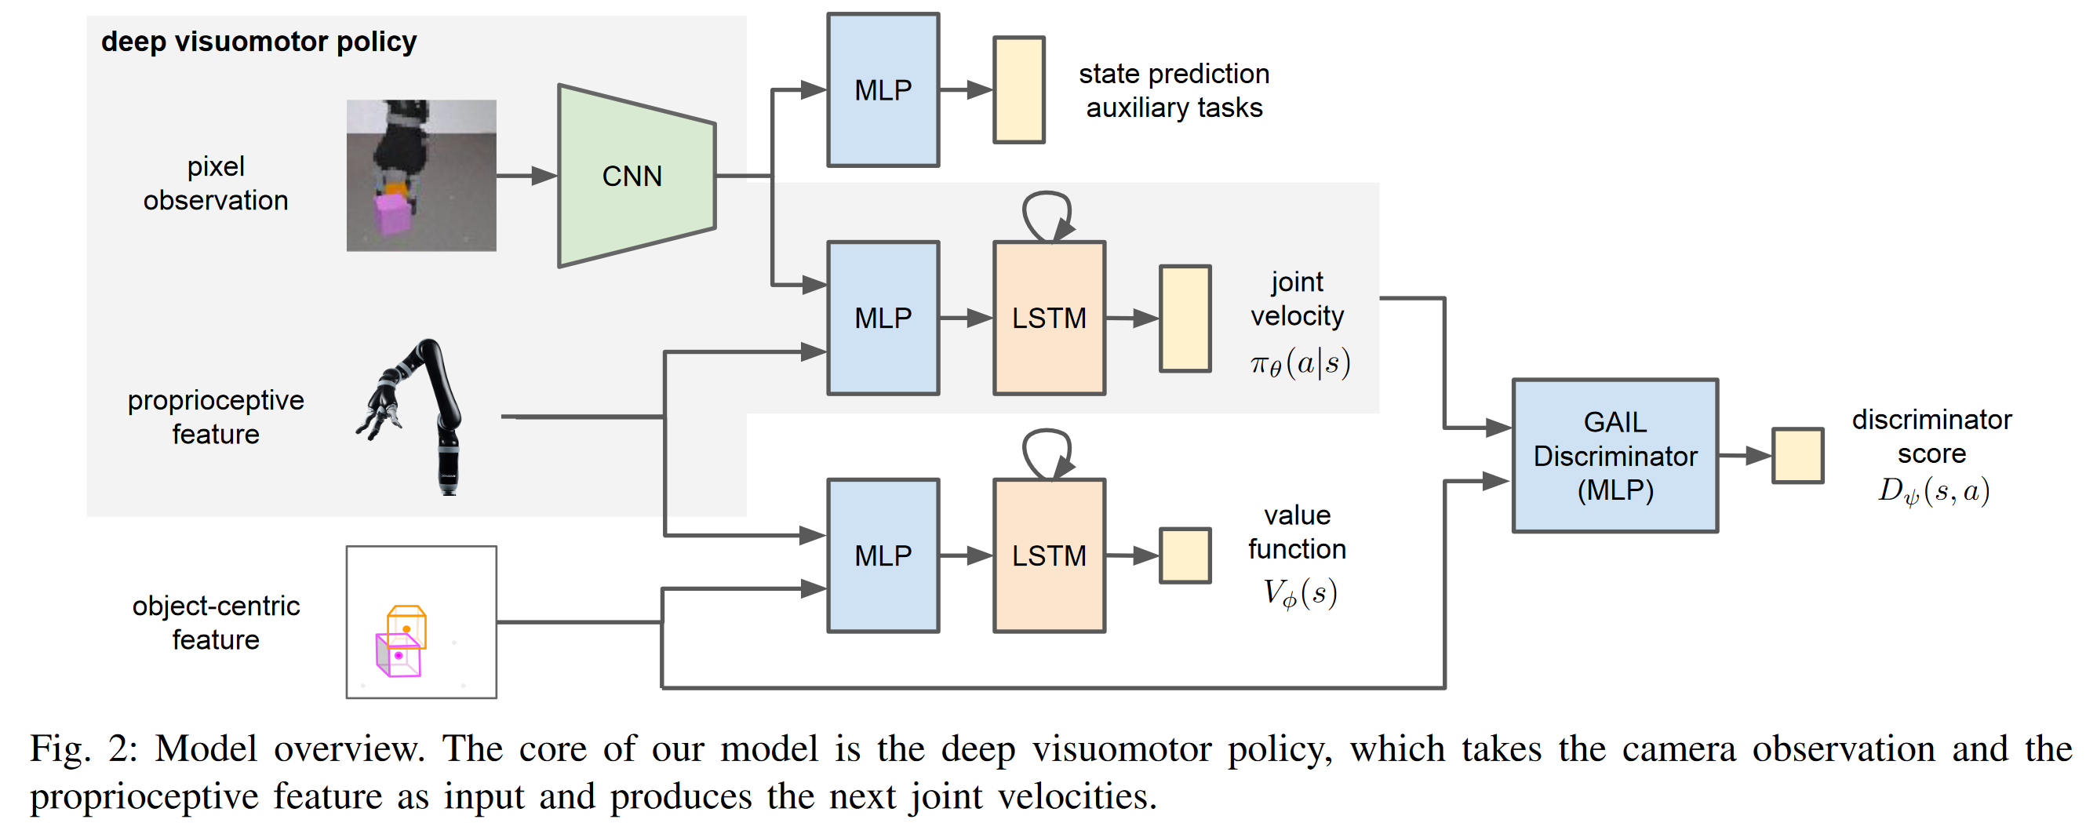
RGB
Simulation Manually Adjusted
Reinforcement and Imitation Learning for Diverse Visuomotor Skills
a Kinect camera (RGBD) was visually calibrated to match the position and orientation of the simulated camera, and the simulation’s dynamics parameters were manually adjusted to match the dynamics of the real arm.
GAIL : Generative Adversarial Imitation Learning
Notes:
CNN + LSTM to handle the information from camera
intuitive
Gray part is the policy
Others are simulation
Advantage:
It could learn from the past (LSTM)
Limitation:
During the training, LiDAR is required
For object-centric feature
Manually adjustment

Slide 4
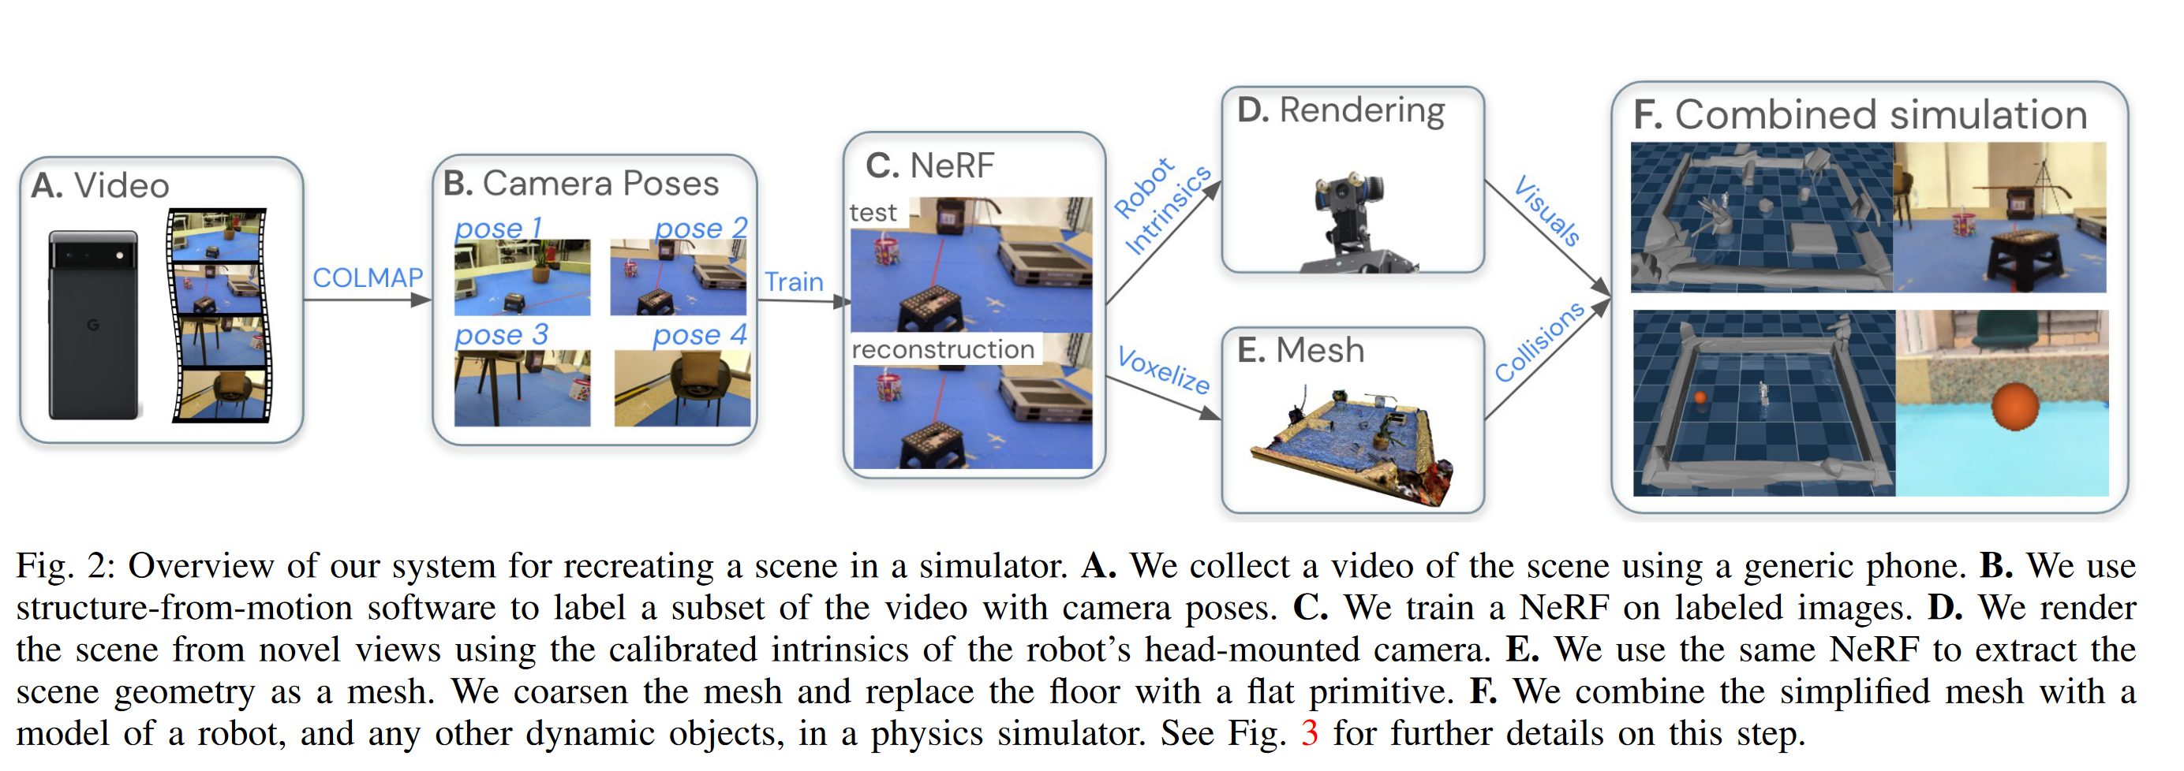
RGB
Neural Field
Nerf2real: Sim2real transfer of vision-guided bipedal motion skills using neural radiance fields
Sensor : Camera(Phone)
Notes:
5-7 mins video
Camera pose : COLMAP
Simulator : dynamics object
Advantage:
High precision from Nerf
Easy to construct the environment (a generic phone)
Limitation
Manual postprocessing, robot camera -> simulator
Long time processing and high computational intensity
- COLMAP: 3-4h
- Nerf : 20min on 8 V100 GPU
- Policy : 24h
3. Dynamic (MuJoCo)-Static(Nerf) Object seperation

Slide 5
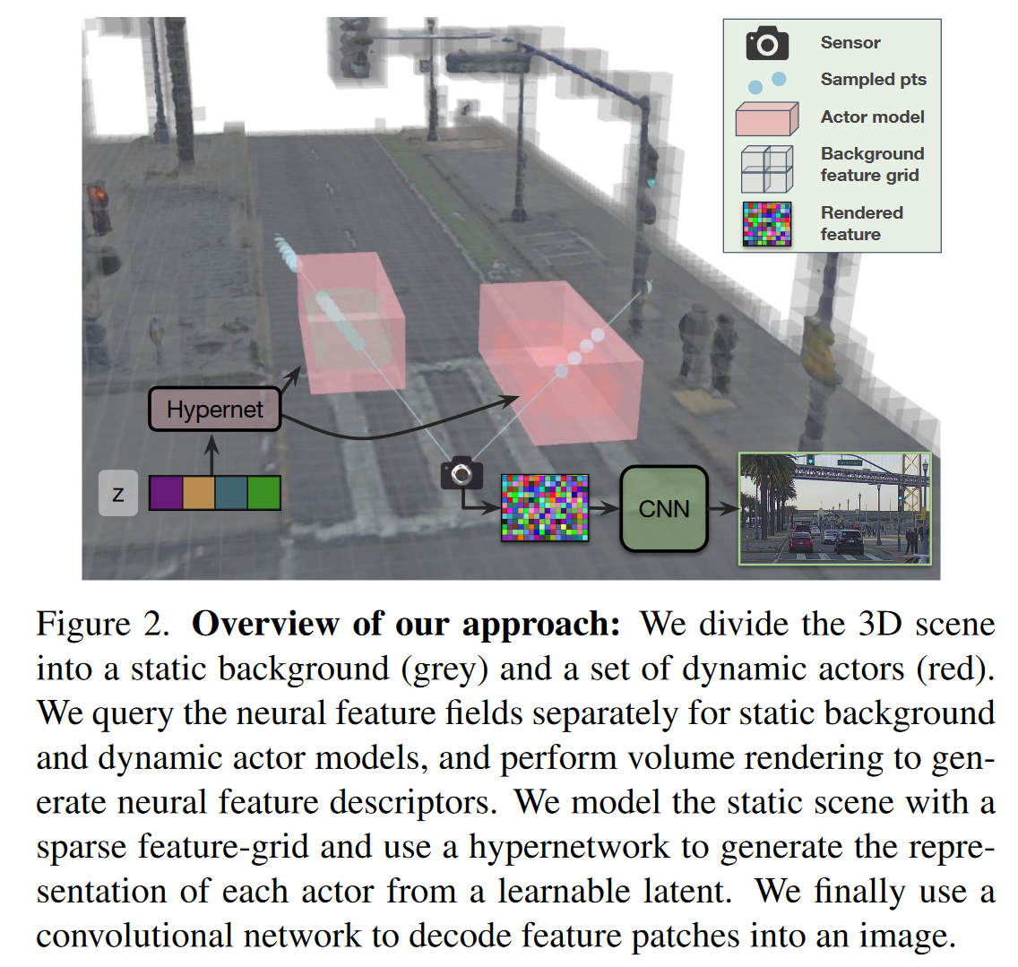
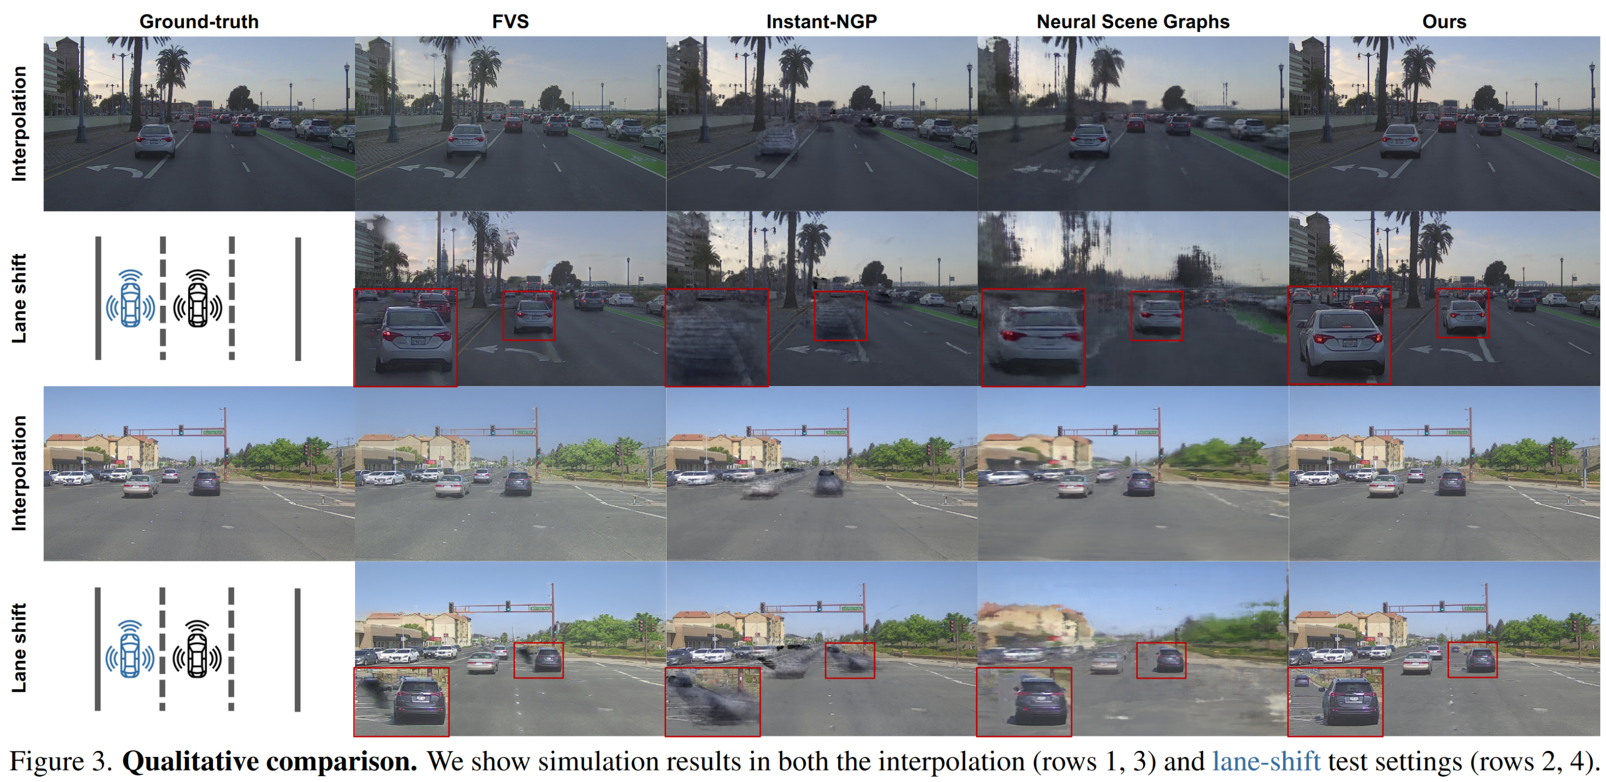
RGB
Neural Field
UniSim: A Neural Closed-Loop Sensor Simulator
Sensor : Camera & LiDAR
Notes:
fuse Dynamic + Static
Simulation Environment
Relation to Last Work:
1. Neural Scene
Advantage:
1. Less complexity (without training a Nerf)
2. couple dynamic objects and static objects
Limitation:
1. LiDAR required
Neural Sensor
CNN modeling
Closed loop simulation

Slide 6
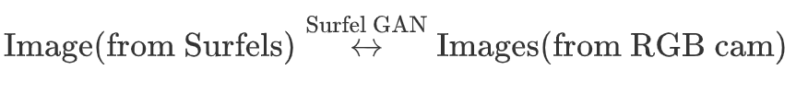
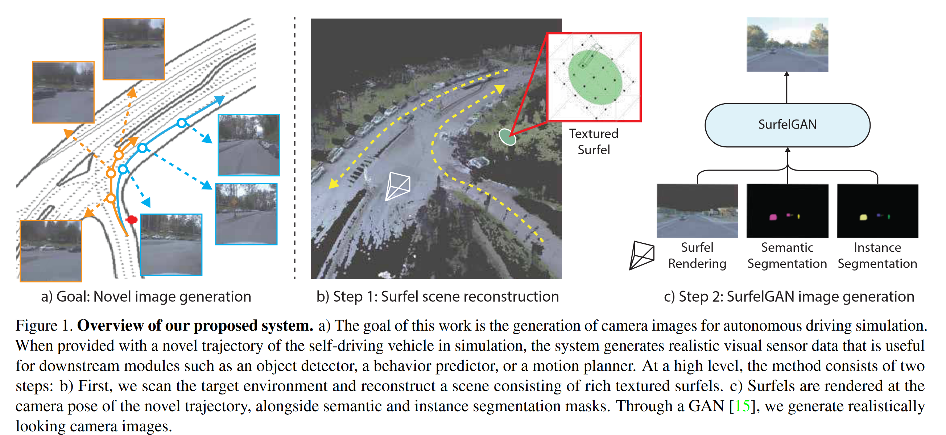
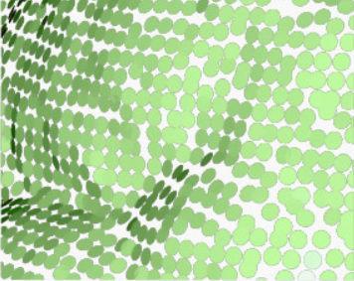
RGB
Synthetic Dataset
SurfelGAN: Synthesizing Realistic Sensor Data for Autonomous Driving
Sensor: Camera & LiDAR
Purpose : Generate
realistically looking
camera images (Texture)
Surfel : A surfel is a small, oriented disk used to represent a portion of a 3D surface.
Notes:
Apart from environment creation,
Dataset Augmentation
Surfel is gained from LiDAR
SurfelGAN : (Surfel Rendered image + Segmentation) -> 2D camera image
Pupose: generate realistic image
Limitation :
1. unable to recover from broken geometry
2. Hallucination : surfel map doesn’t cover

Slide 7
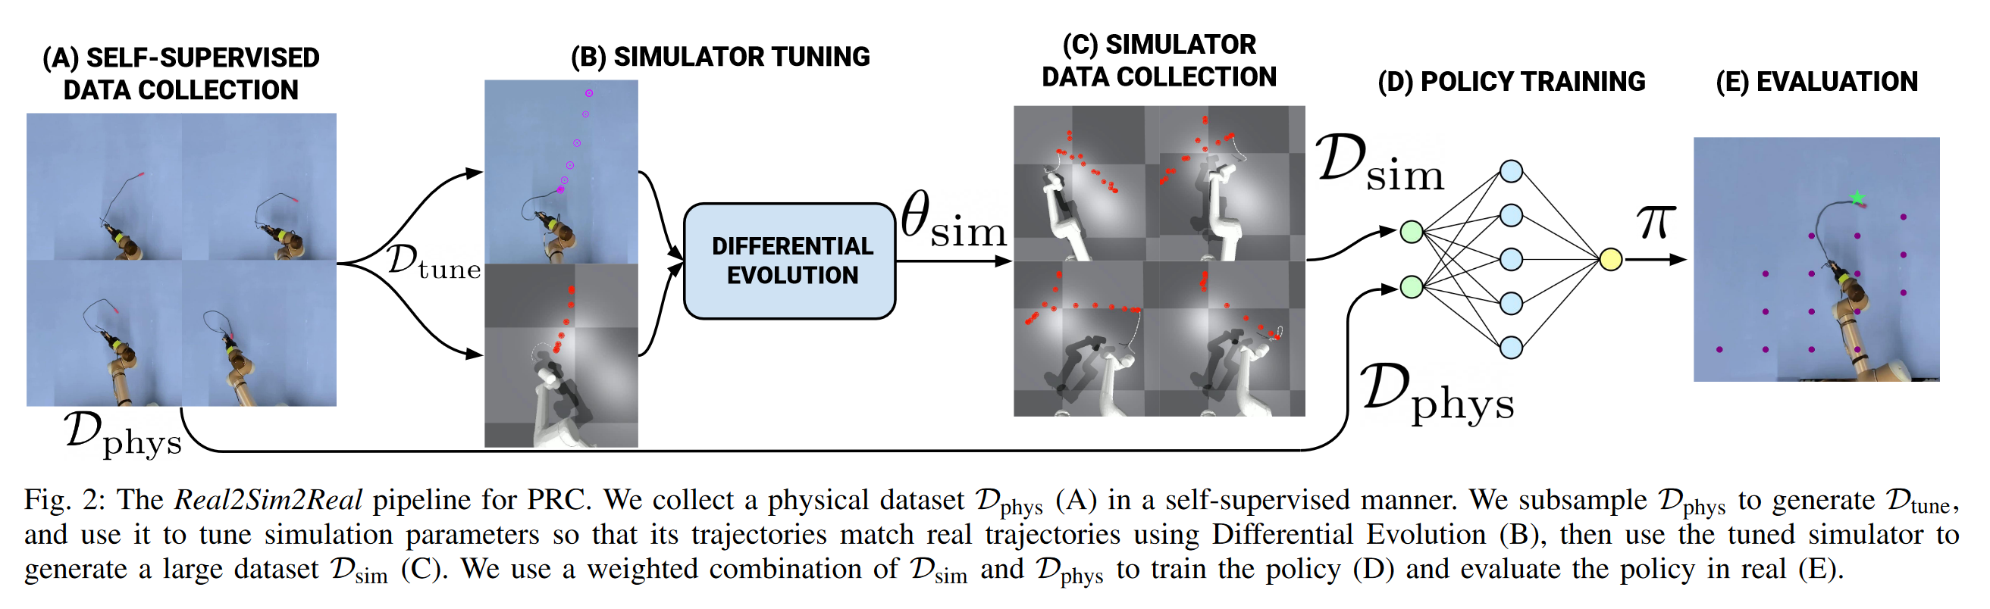
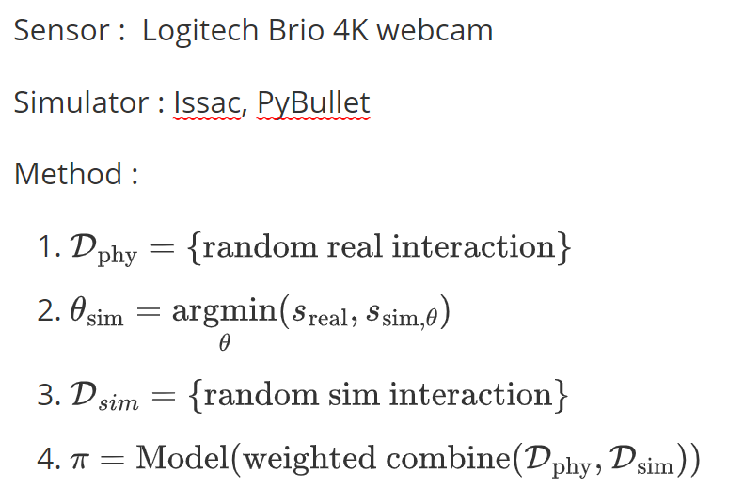
RGB
Synthetic Dataset
Real2Sim2Real: Self-Supervised Learning of Physical Single-Step Dynamic Actions for Planar Robot Casting
PRC : Planar Robot Casting
Notes:
Relationship To Last Work:
Dataset Augmentation
Pipeline :
first, generate a bunch of real world interactive dataset
second, sample a subset from it, and optimize the parameters in the simulation to close the gap between.
third, generate a bunch of simulation interactive dataset
last, combine reald interactive dataset and simulation interactive dataset to train the policy
Advantage:
1. simple and efficient
Limitation ：
1. can hard to extend to other task (Planar Robot Casting)

Slide 8
Depth
Sensors
LiDAR : determining ranges by targeting an object or a surface with a laser and measuring the time for the reflected light to return to the receiver .
Kinect : the motion sensing device for the Xbox 360 gaming console. It provides RGB, Infra-Red (IR), depth, skeleton, and audio streams to an application.
Zed Camera : neural depth, built-in IMU
RealSense : long range depth camera, built-in IMU
Notes:
RGB camera is always limited to one kind of information.
3D position

Slide 9
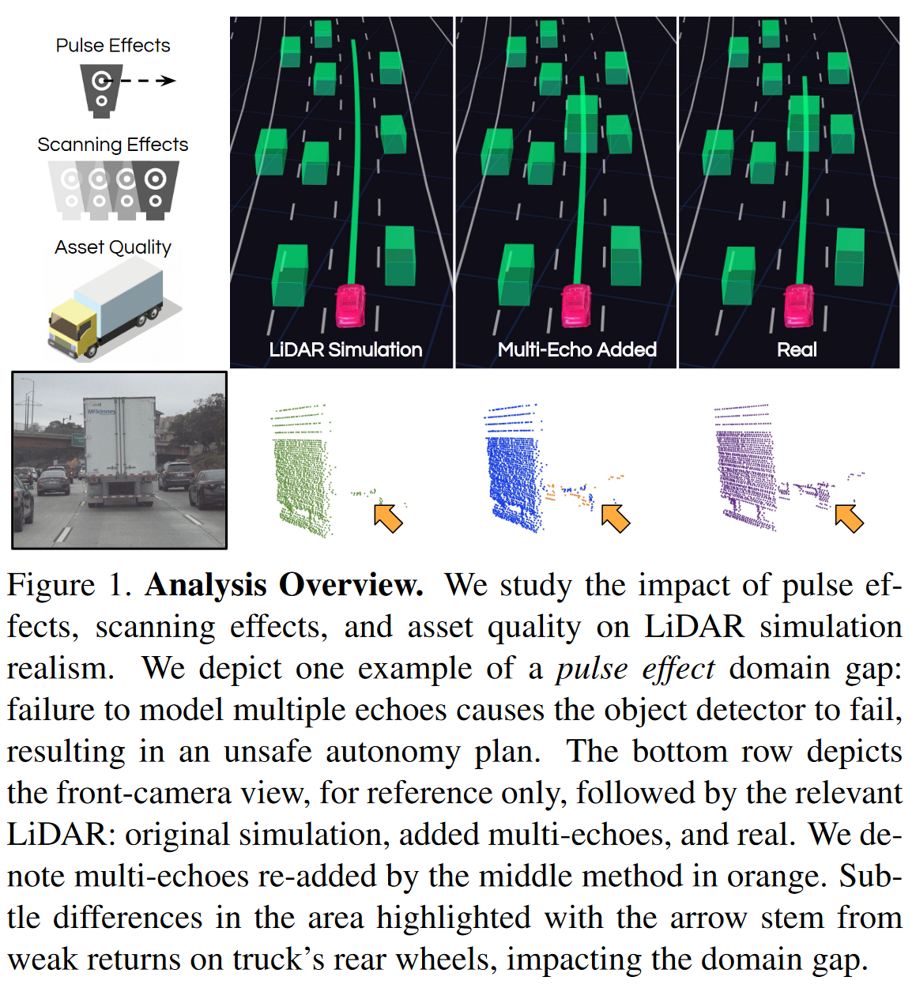
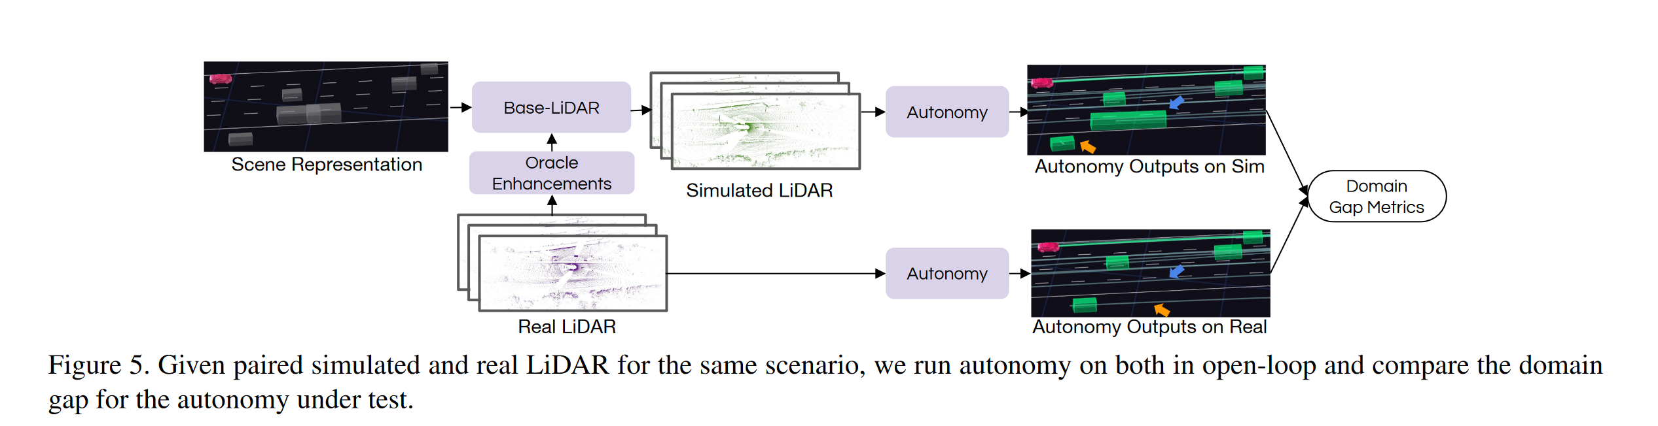
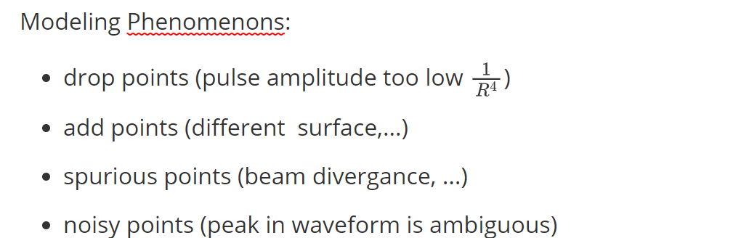
Depth
Simulation Enhancement
Towards Zero Domain Gap: A Comprehensive Study of Realistic LiDAR Simulation for Autonomy Testing
Notes:
As for LiDAR
Uncertainty Phenomenon
Unreturned pulse because of fast amplitude decay
Multiple echos caused by multiple surfaces
Spurious returns caused by beam divergence
Noisy points caused by ambiguity in wavepeak

Slide 10
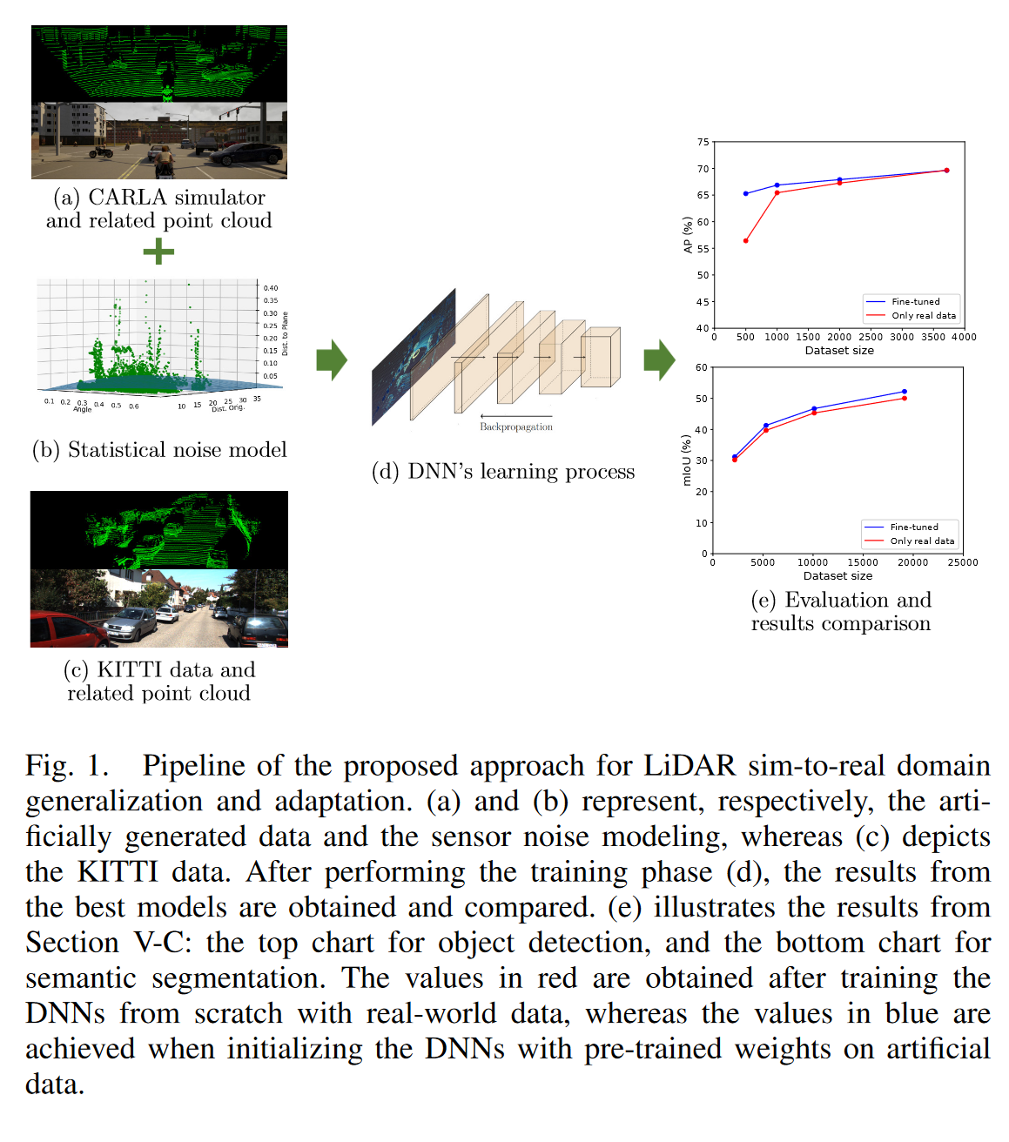
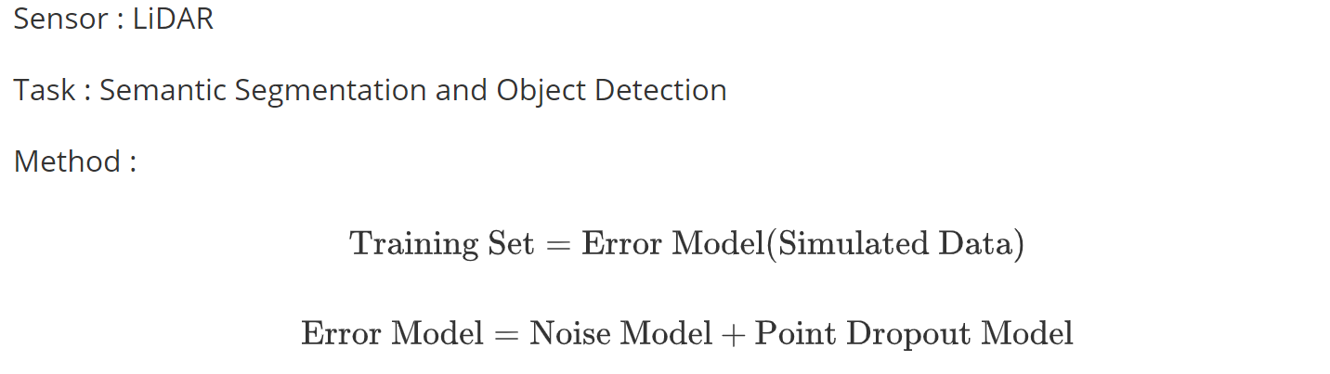
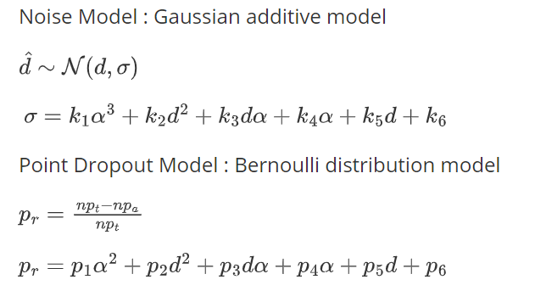
Depth
Domain Randomization
LiDAR Data Noise Models and Methodology for Sim-to-Real Domain Generalization and Adaptation in Autonomous Driving Perception
Notes:
Noise model for LiDAR
- noise points
- drop points
gaussian distribution
deviation of the gaussian model
Point dropout model
Bernoulli distribution
Quadratic polynomial

Slide 11
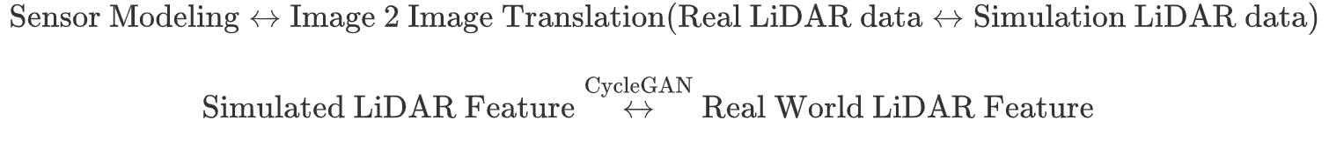
Depth
Realistic Simulation
LiDAR Sensor modeling and Data augmentation with GANs for Autonomous driving
Sensor: LiDAR
Notes:
Neural Network Modeling
Similar to SurfelGAN
Model the transition from simulated LiDAR to sim LiDAR using Cycle GAN
Generate high realistic LiDAR

Slide 12
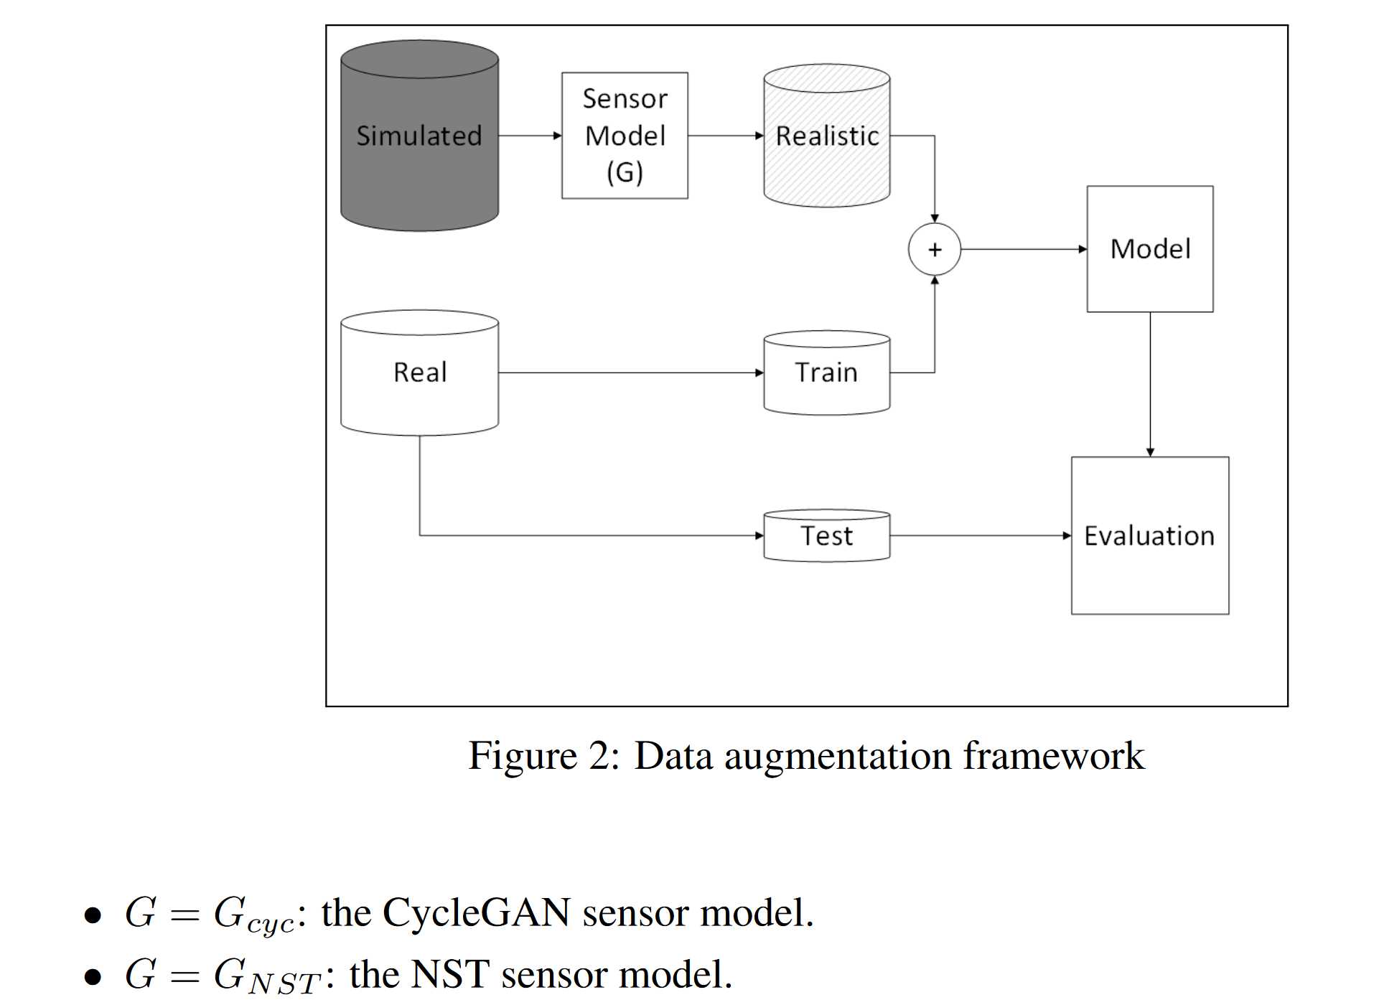
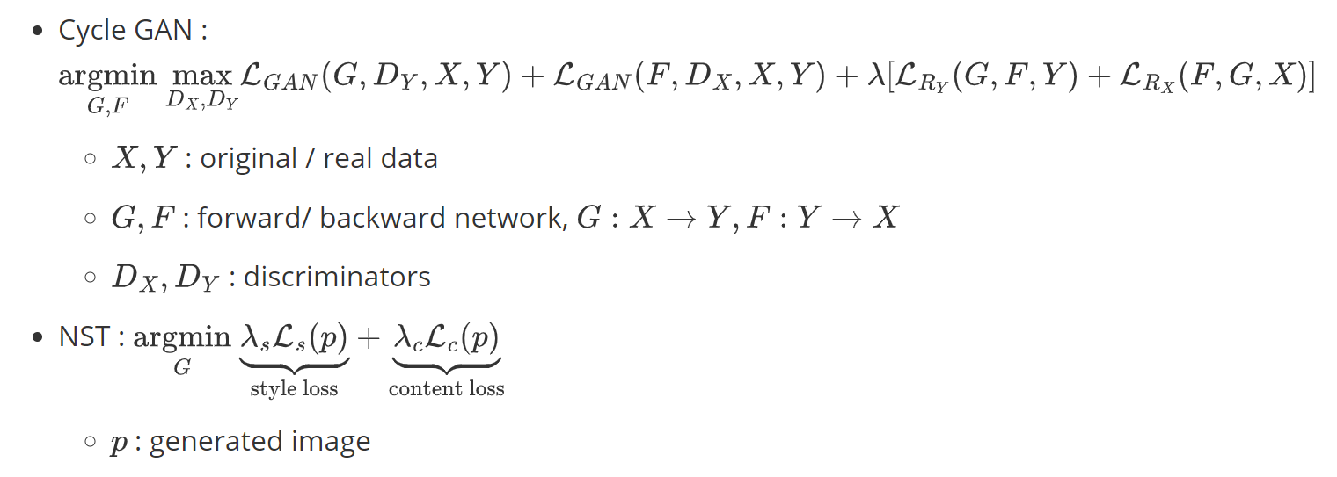
Depth
Data Augmentation
Unsupervised Neural Sensor Models for Synthetic LiDAR Data Augmentation
Notes:
Futher from (same author) last work
Here, they use a general generation model which can be CycleGAN, Neural Style Transfer
The total trainig dataset is the combination of realistic dataset and augmented dataset

Slide 13
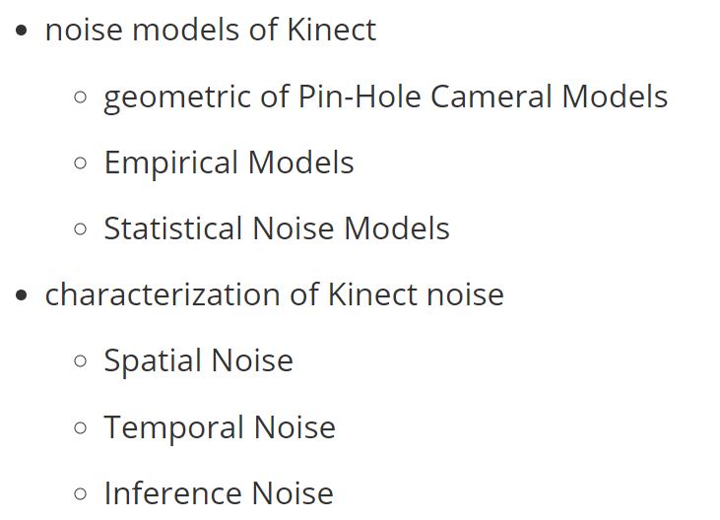
Depth
Kinect Survey
Characterizations of Noise in Kinect Depth Images: A Review
Notes:
There is also a work provide the sensor modeling for Kinect.
Based on these modeling, they could sperate the noise into three categories

Slide 14
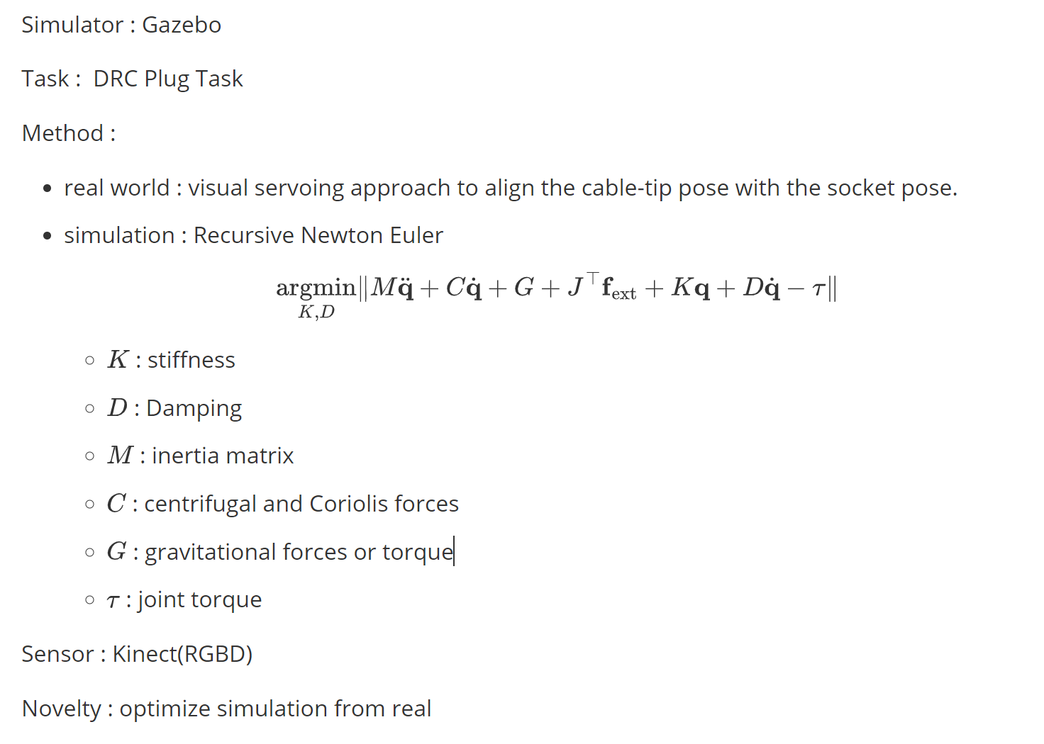
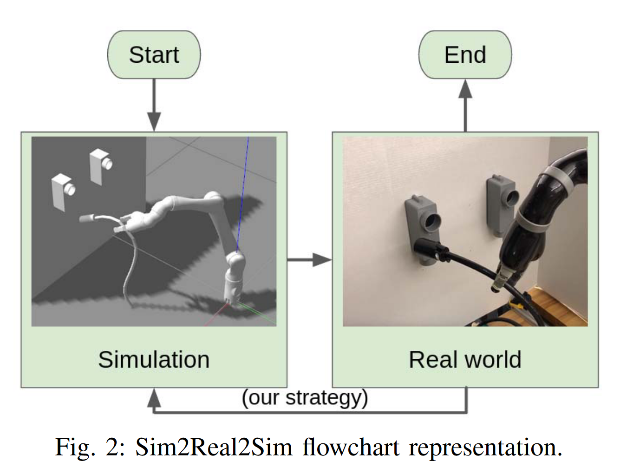
Depth
Realistic Simulation
Sim2Real2Sim: Bridging the Gap Between Simulation and Real-World in Flexible Object Manipulation
Notes:
The work sim2real2sim focus on DRC(DARPA Robotics Challenge) Plug task
They use a visual servoing approach, which uses the reverse Jacobian of the difference between preinsert frame and cable tip frame to align the pose. Therefore, it could update the parameters in the simulation.

Slide 15
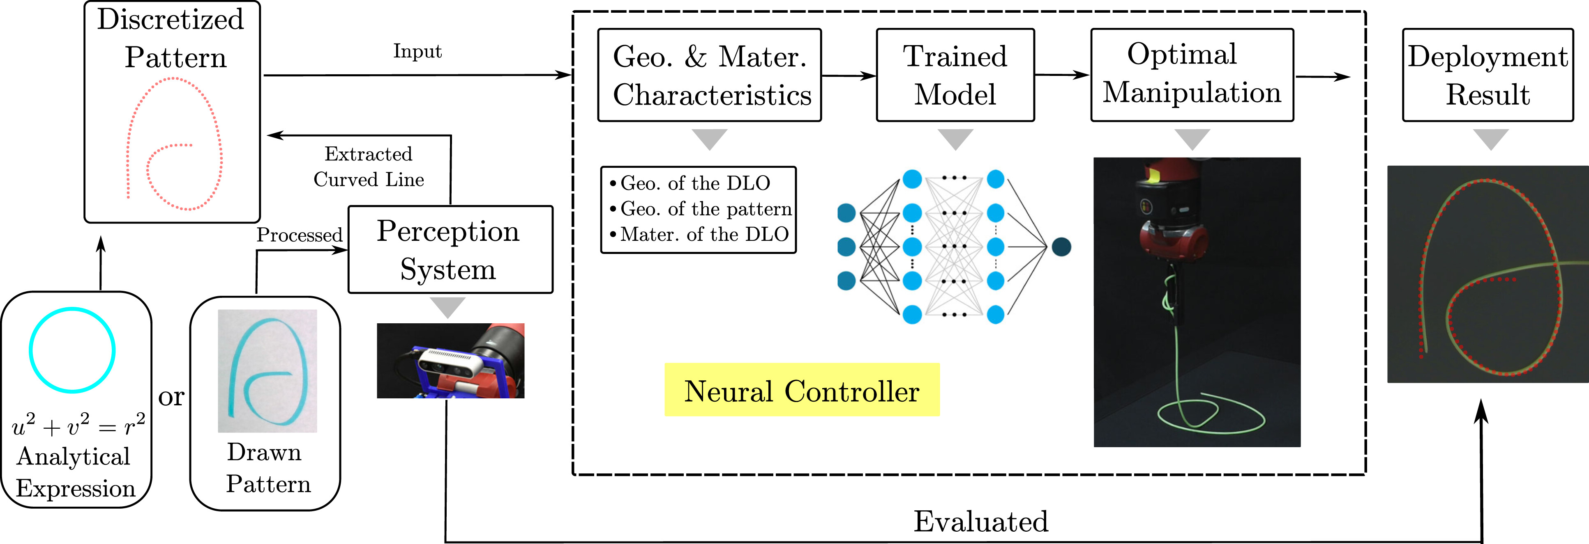
Depth
Naive
Sim2Real Neural Controllers for Physics-Based Robotic Deployment of Deformable Linear Objects
DLO : Deformable linear objects
Notes:
As for the modern camera, Realsense
This work focus on Deformed Linear Objects Problem.
The 3D position of the nodes on the linear objects are directly gained from the RealSense camera

Slide 16
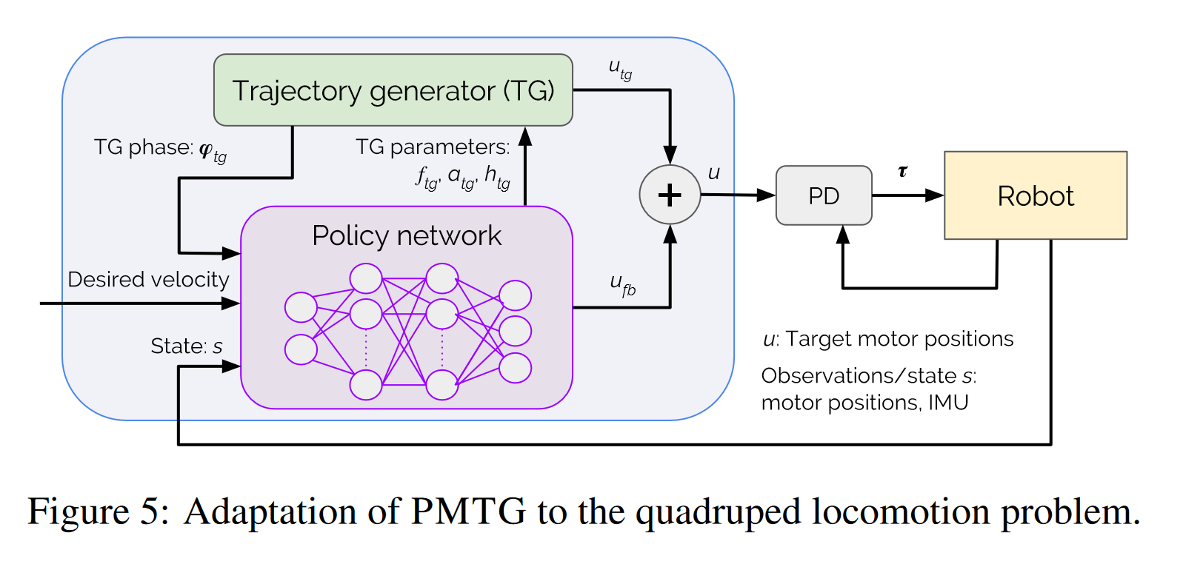
IMU
Policy Modal
Policies Modulating Trajectory Generators
Sample at a certain freqeuncy
Notes:
Interial Measurement Unit is primarily used for measuring acceleration.
It’s always used with other sensors like RGBD cam and encoders.
The signal frequencies are different.
Constant frequency sampling. -> policy network
Loss the information in the interval

Slide 17
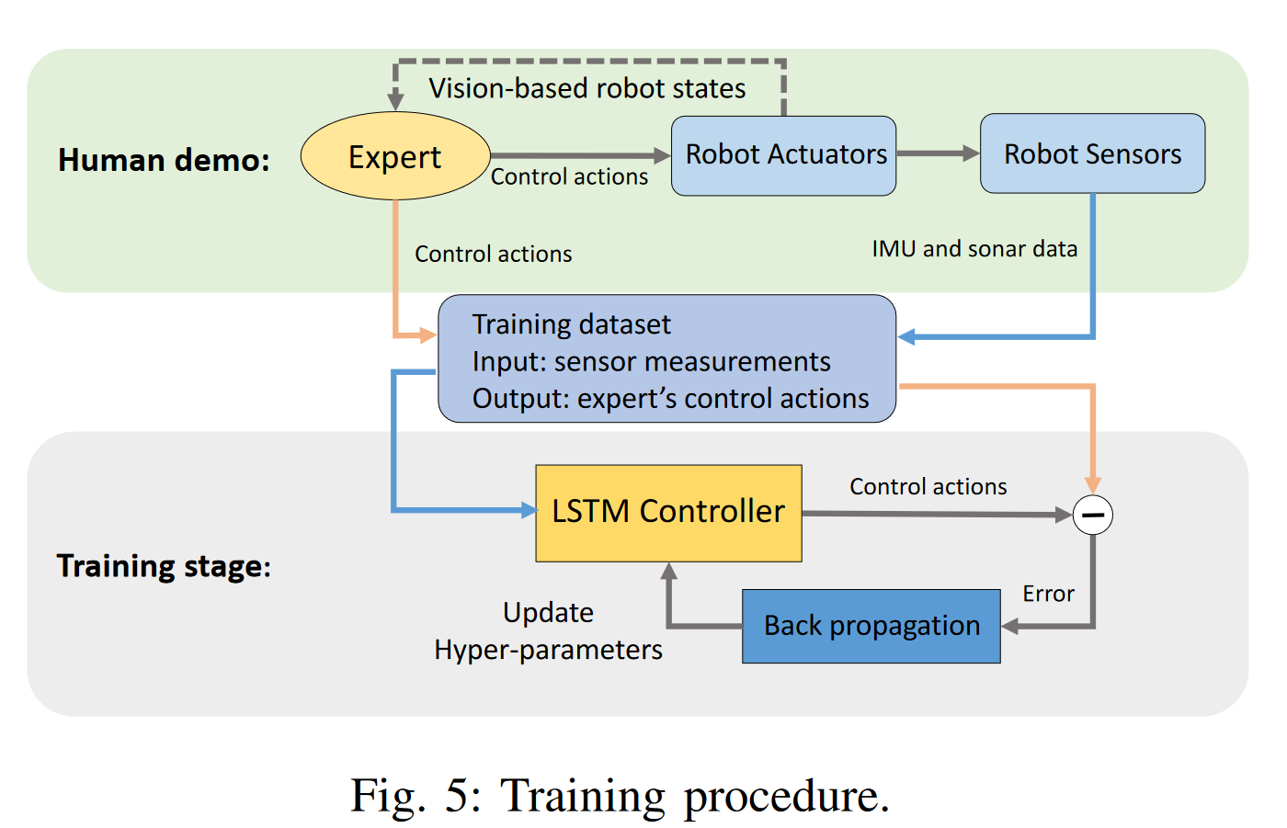
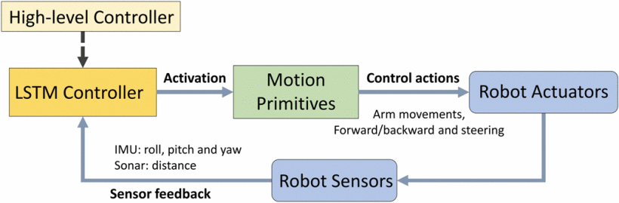
IMU
Controller Modal
Learning Autonomous Mobility Using Real Demonstration Data)
Butterworth loss-pass filter with 15Hz to denoise and outlier removal
LSTM interpret time-seq signals
Notes:
To better use the high frequency signal
Butterworth low-pass filter with 15Hz to denoise and outlier removal.
LSTM controller to interpret these time-seq signals
The policy could only work at a low frequency

Slide 18
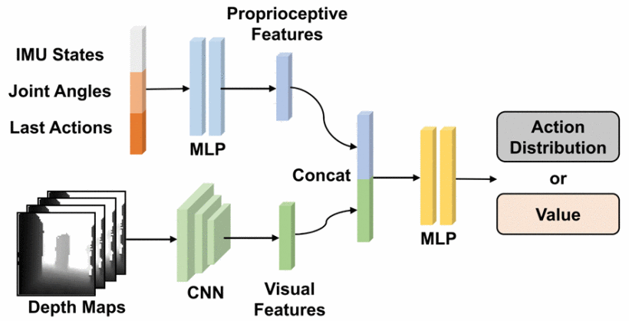
IMU
Policy Modal
Sim-to-Real Strategy for Spatially Aware Robot Navigation in Uneven Outdoor Environment
Observation buffer
Notes:
Visual observation buffer, which buffer the depth information to make it synchronous with IMU signals
High frequency.

Slide 19
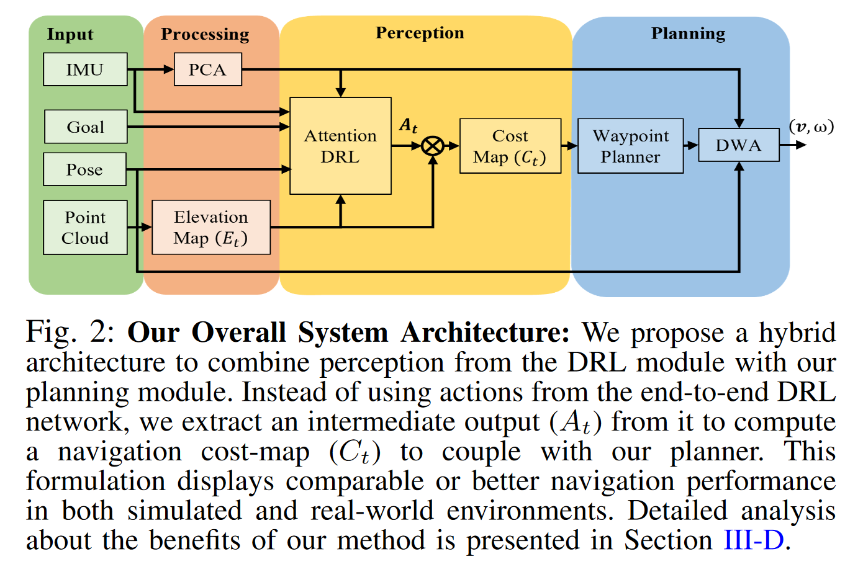
IMU
Policy Modal
Sim-to-Real Strategy for Spatially Aware Robot Navigation in Uneven Outdoor Environment
Extract surface vibration using PCA (first two principle components)
DWA: Dynamic Window Approach to penalize velocities that could cause robot flip-overs
Notes:
Extract information from IMU
Extract surface vibration using PCA
First two principle components.
Dynamic Window Approach penalize velocity prevent from flip-over.

Slide 20
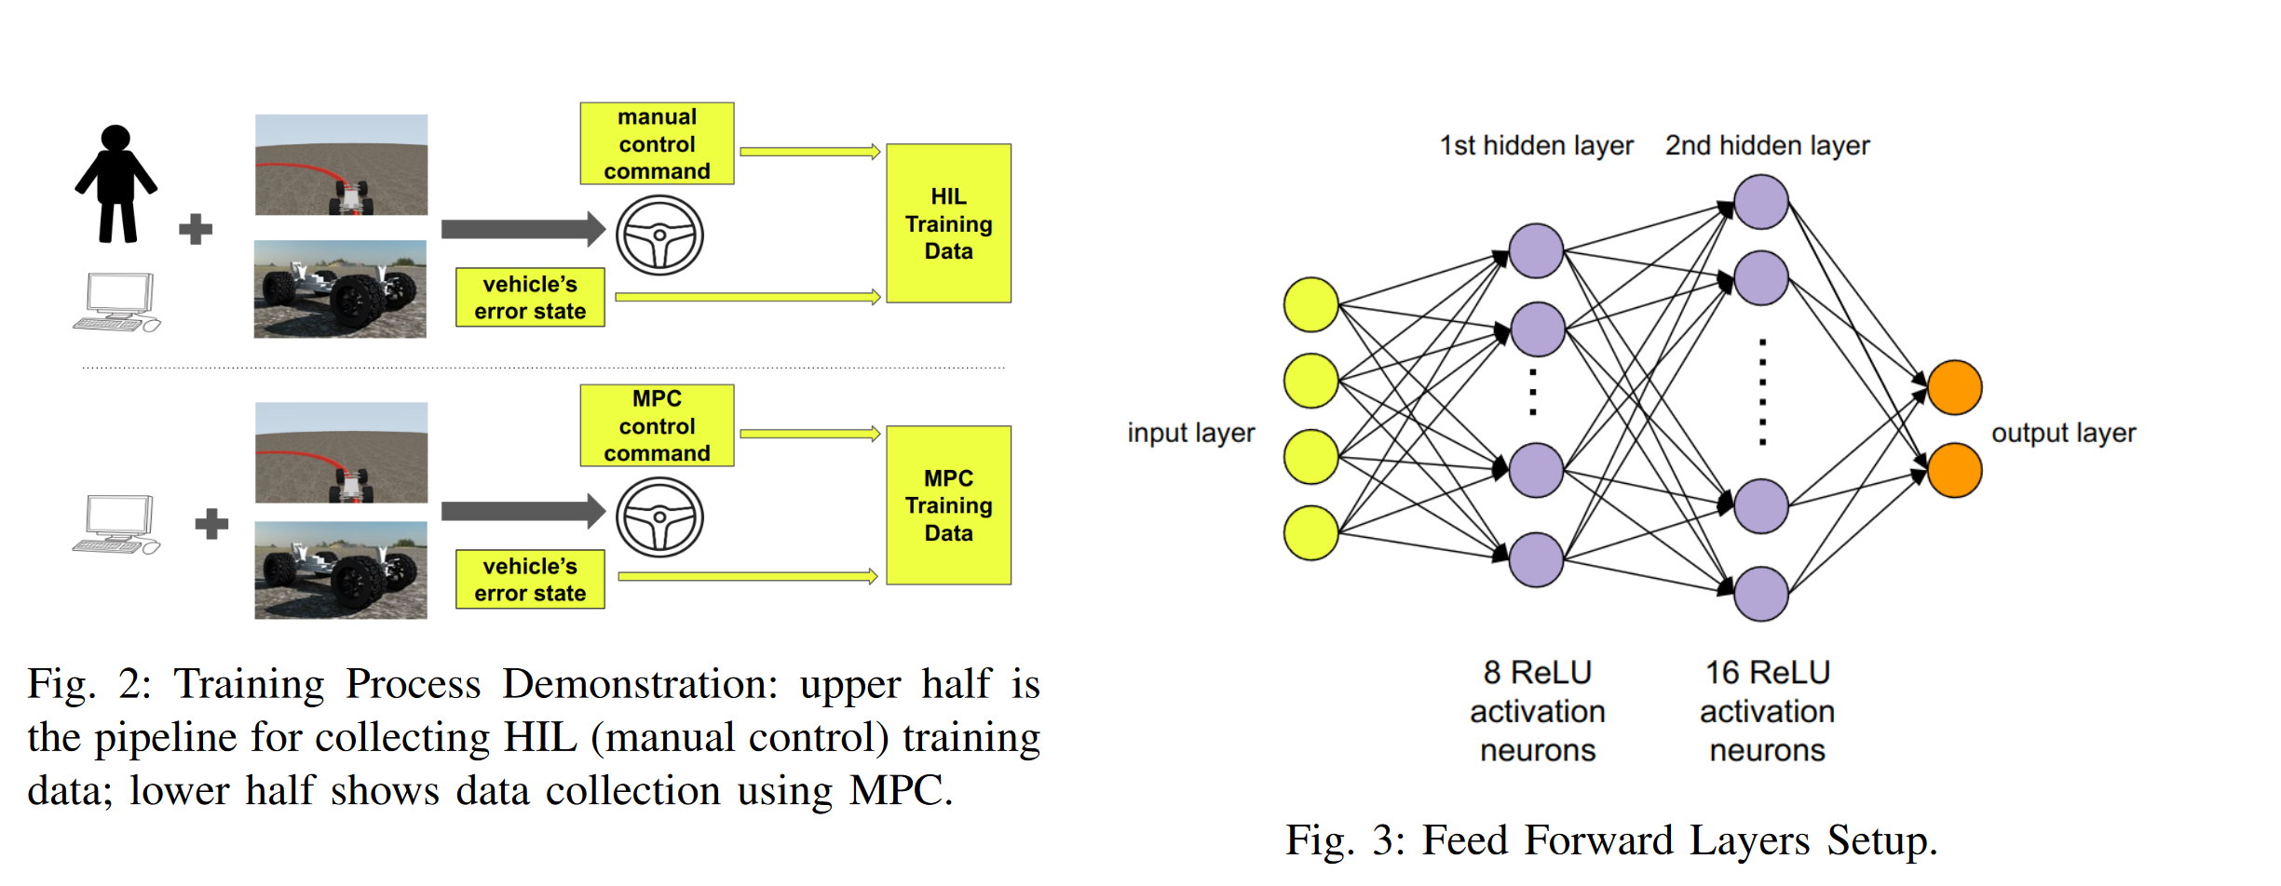
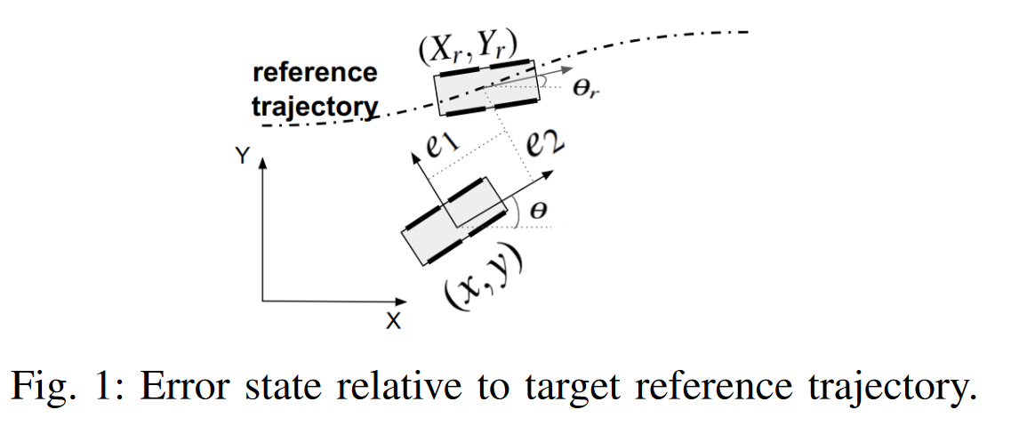
IMU
Advantage:
- explainable coupled with IMU signal
Limitation :
- naive control
- IMU signal is assumed to be exact
Error Estimation
Zero-Shot Policy Transferability for the Control of a Scale Autonomous Vehicle
IMU for error estimation
Notes:
IMU -> heading information
Extract error state combined with GPS signals
IMU -> EKF
Error state-> model predictive controller -> navigation accuracy

Slide 21
Force Sensor
Review
Robotic tactile perception of object properties: A review
Single-point contact sensor :
measure contact force : ATI Nano 17 force-torque sensor
measure vibration : biomimeticwhiskers
Tactile Array: fiber optics, MEMS barometers, RoboTouch, DigiTacts
optical tactile sensor, high resolution : GelSight, GelTip, TacTip, DIGIT
Notes:
As for the force sensors
They could be categories into three main classes

Slide 22
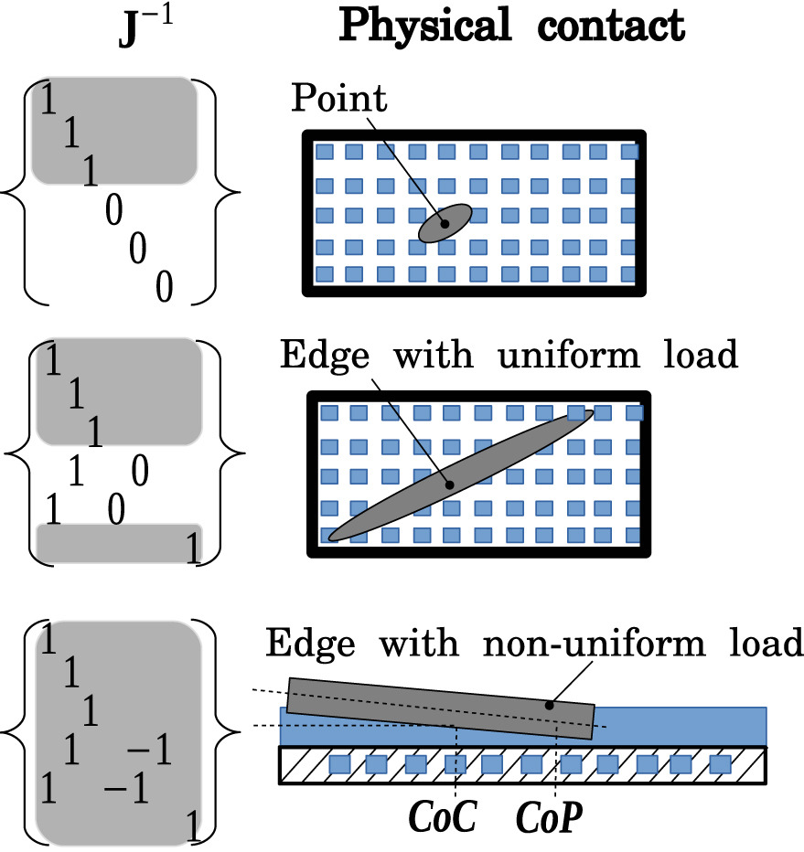
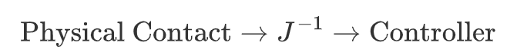
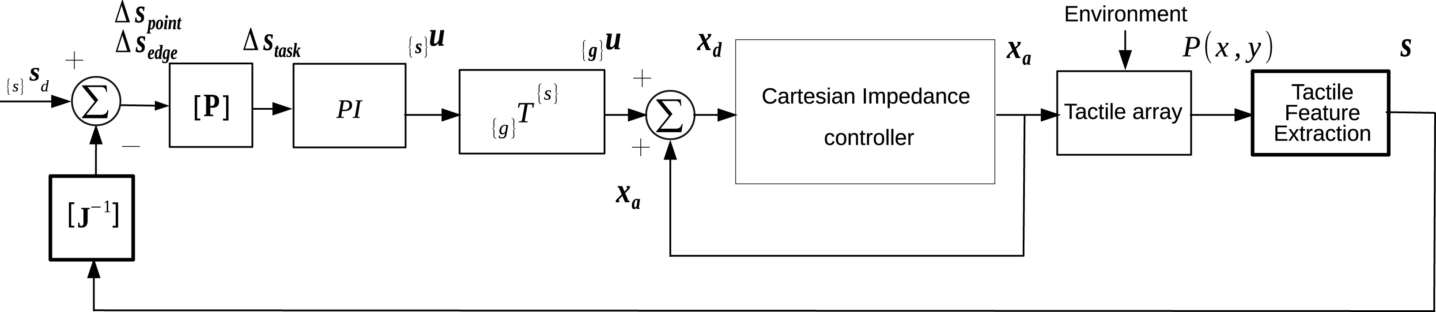
Force Sensor
Jacobian feed forward
Touch driven controller and tactile features for physical interactions
Notes:
The traditional way to model tactile array
Numerical approach
Contact pattern -> Jacobian -> controller system
Numerical robust
Contact pattern should be computed manually

Slide 23
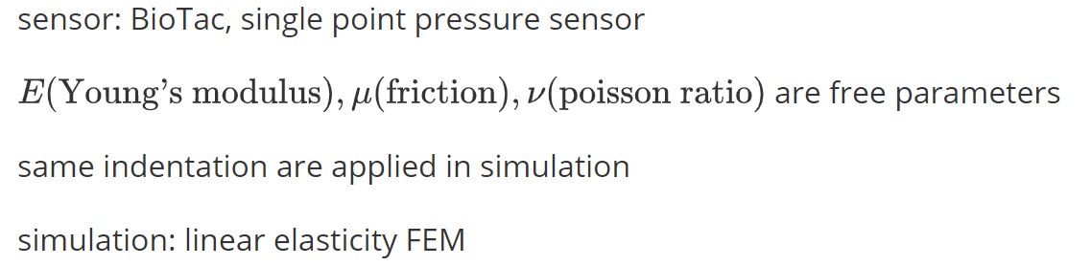
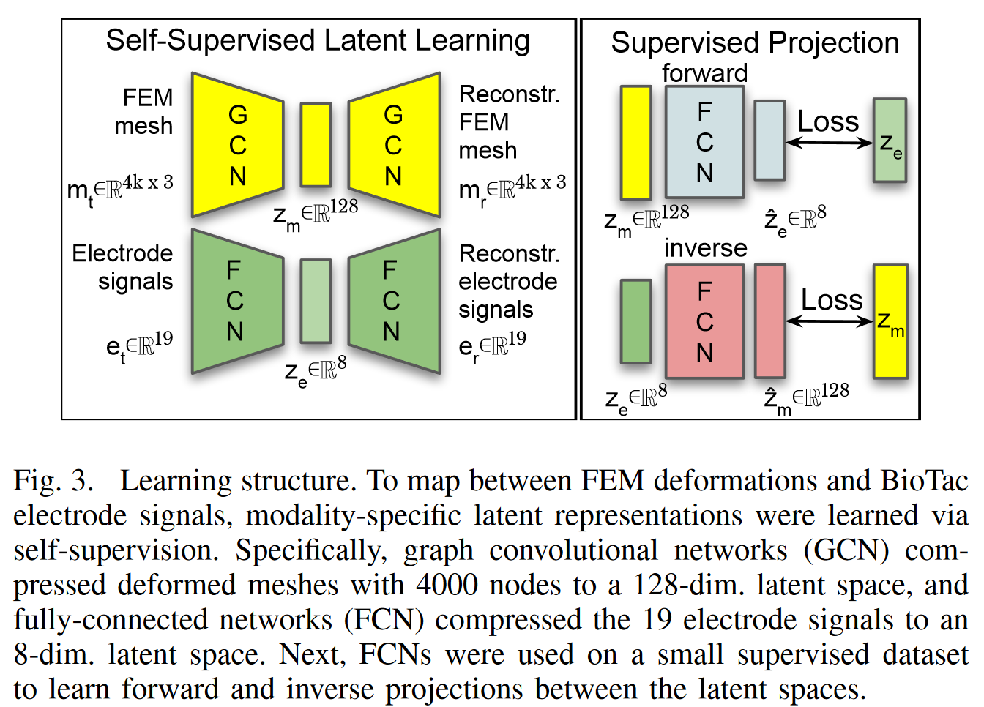
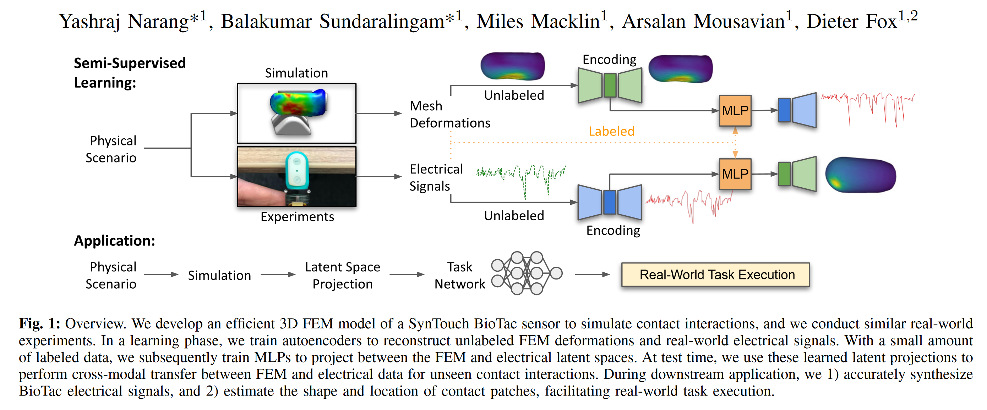
Force Sensor
FEM Simulation
Sim-to-Real for Robotic Tactile Sensing via Physics-Based Simulation and Learned Latent Projections
Notes:
For Specialized shape sensor : SynTouch BioTach
Two VAE -> Two Latent Space -> Two MLP bridge the gap between two latent spaces
FEM is of high accuracy, it could measure any contact pattern

Slide 24
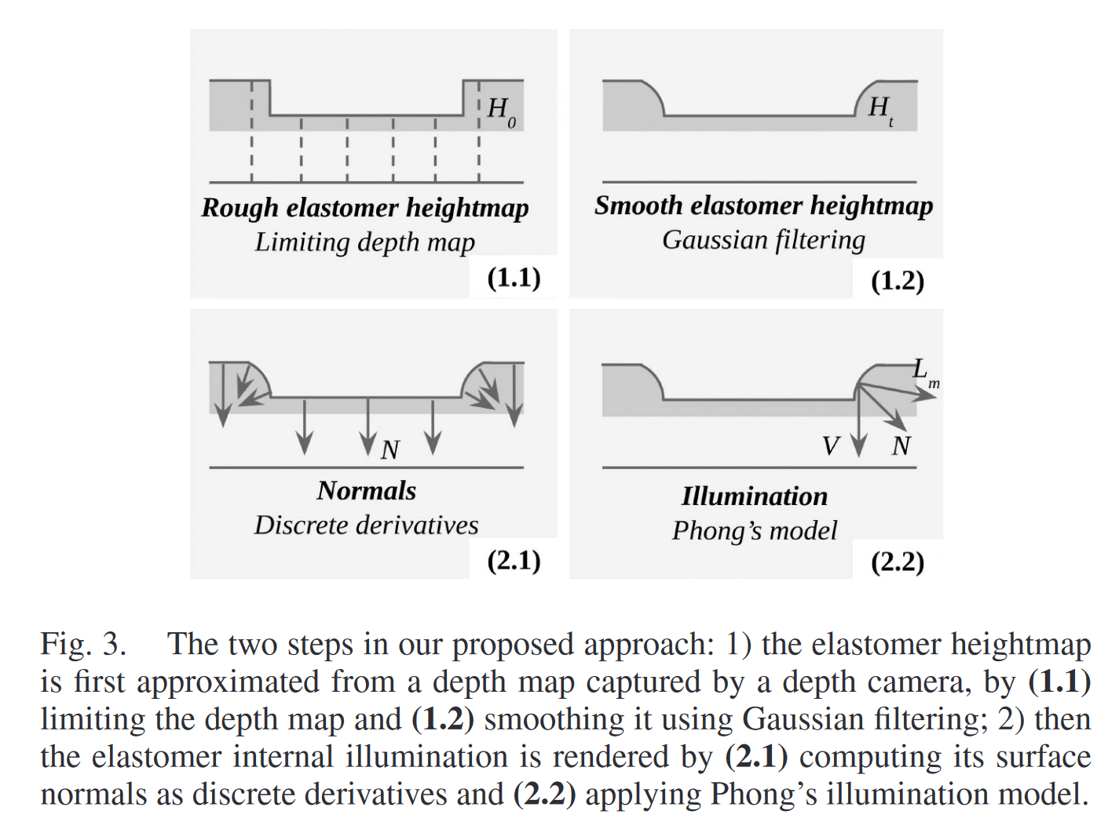
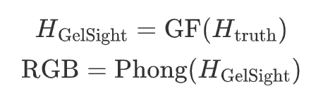
Force Sensor
Simulation Enhancement
Generation of GelSight Tactile Images for Sim2Real Learning
Sensor : GelSight
Simulator : Gazebo
Notes:
As for optical tactile,
Deformation – rendering model
Gaussian filter -> strain membrain.
Phong’s shading render the image.
Forward method
Fast and robust
Not accurate enough

Slide 25
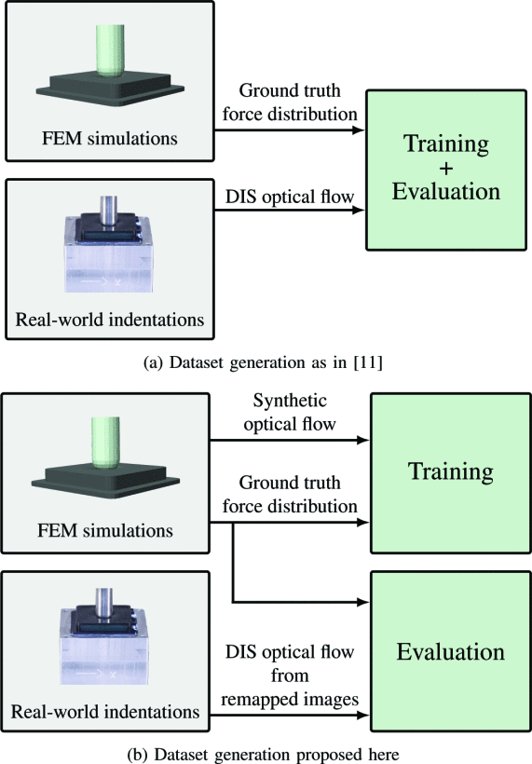
Force Sensor
FEM Simulation
Learning the sense of touch in simulation: a sim-to-real strategy for visionbased tactile sensing
figure a is corresponding to paper "Ground Truth Force Distribution for Learning-Based Tactile Sensing: A Finite Element Approach”
DIS: Dense Inverse Search (Fast Optical Flow using Dense Inverse Search)
Notes:
FEM could also be used here.
What we need is to use a model as a transition between the FEM simulation and the real world observation.
First method, force distribution
Second method , optical flow + force distribution

Slide 26
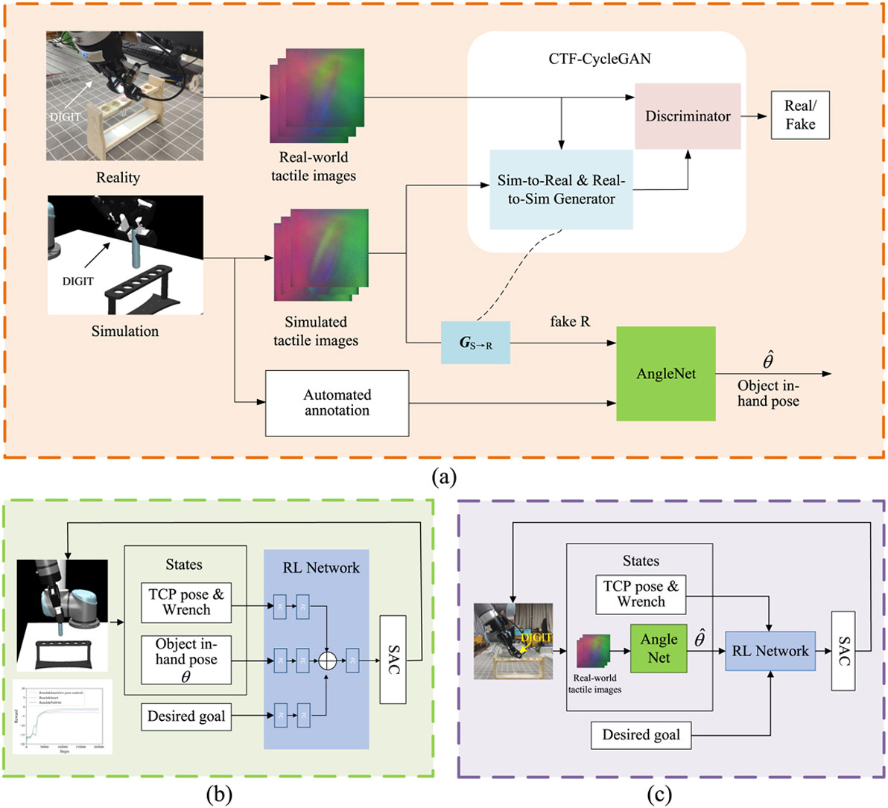
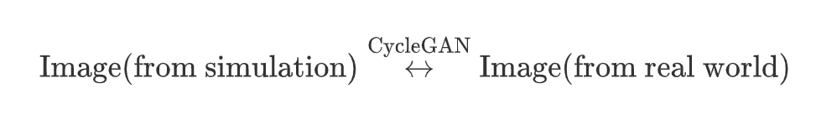
Force Sensor
Simulation Enhancement
Skill generalization of tubular object manipulation with tactile sensing and Sim2Real learning
Sensor : DIGIT
SAC : Soft Actor-Critic
TCP : Tool Center Point
Notes:
Specific Task: In-hand pose of tubar objects.
The transformation could also be learned using a CycleGAN.
CycleGAN-like architecture model the transformation from simulated image to realistic representation

Slide 27
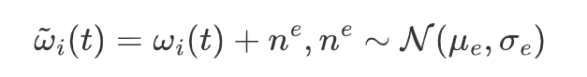
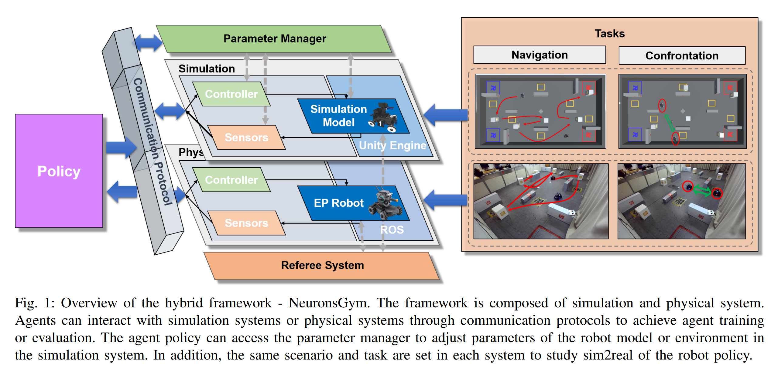
Encoders
Uncertainty Estimation
NeuronsGym: A Hybrid Framework and Benchmark for Robot Tasks with Sim2Real Policy Learning
A simulator framework
Notes:
Encoders inside motor
Angular velocity , torque -> electrical data
In this simulation framework called NeuraonGym, the encoders are modeled using Guassian noise
/how to get \mu \sigma
/not much work on encoders

Slide 28
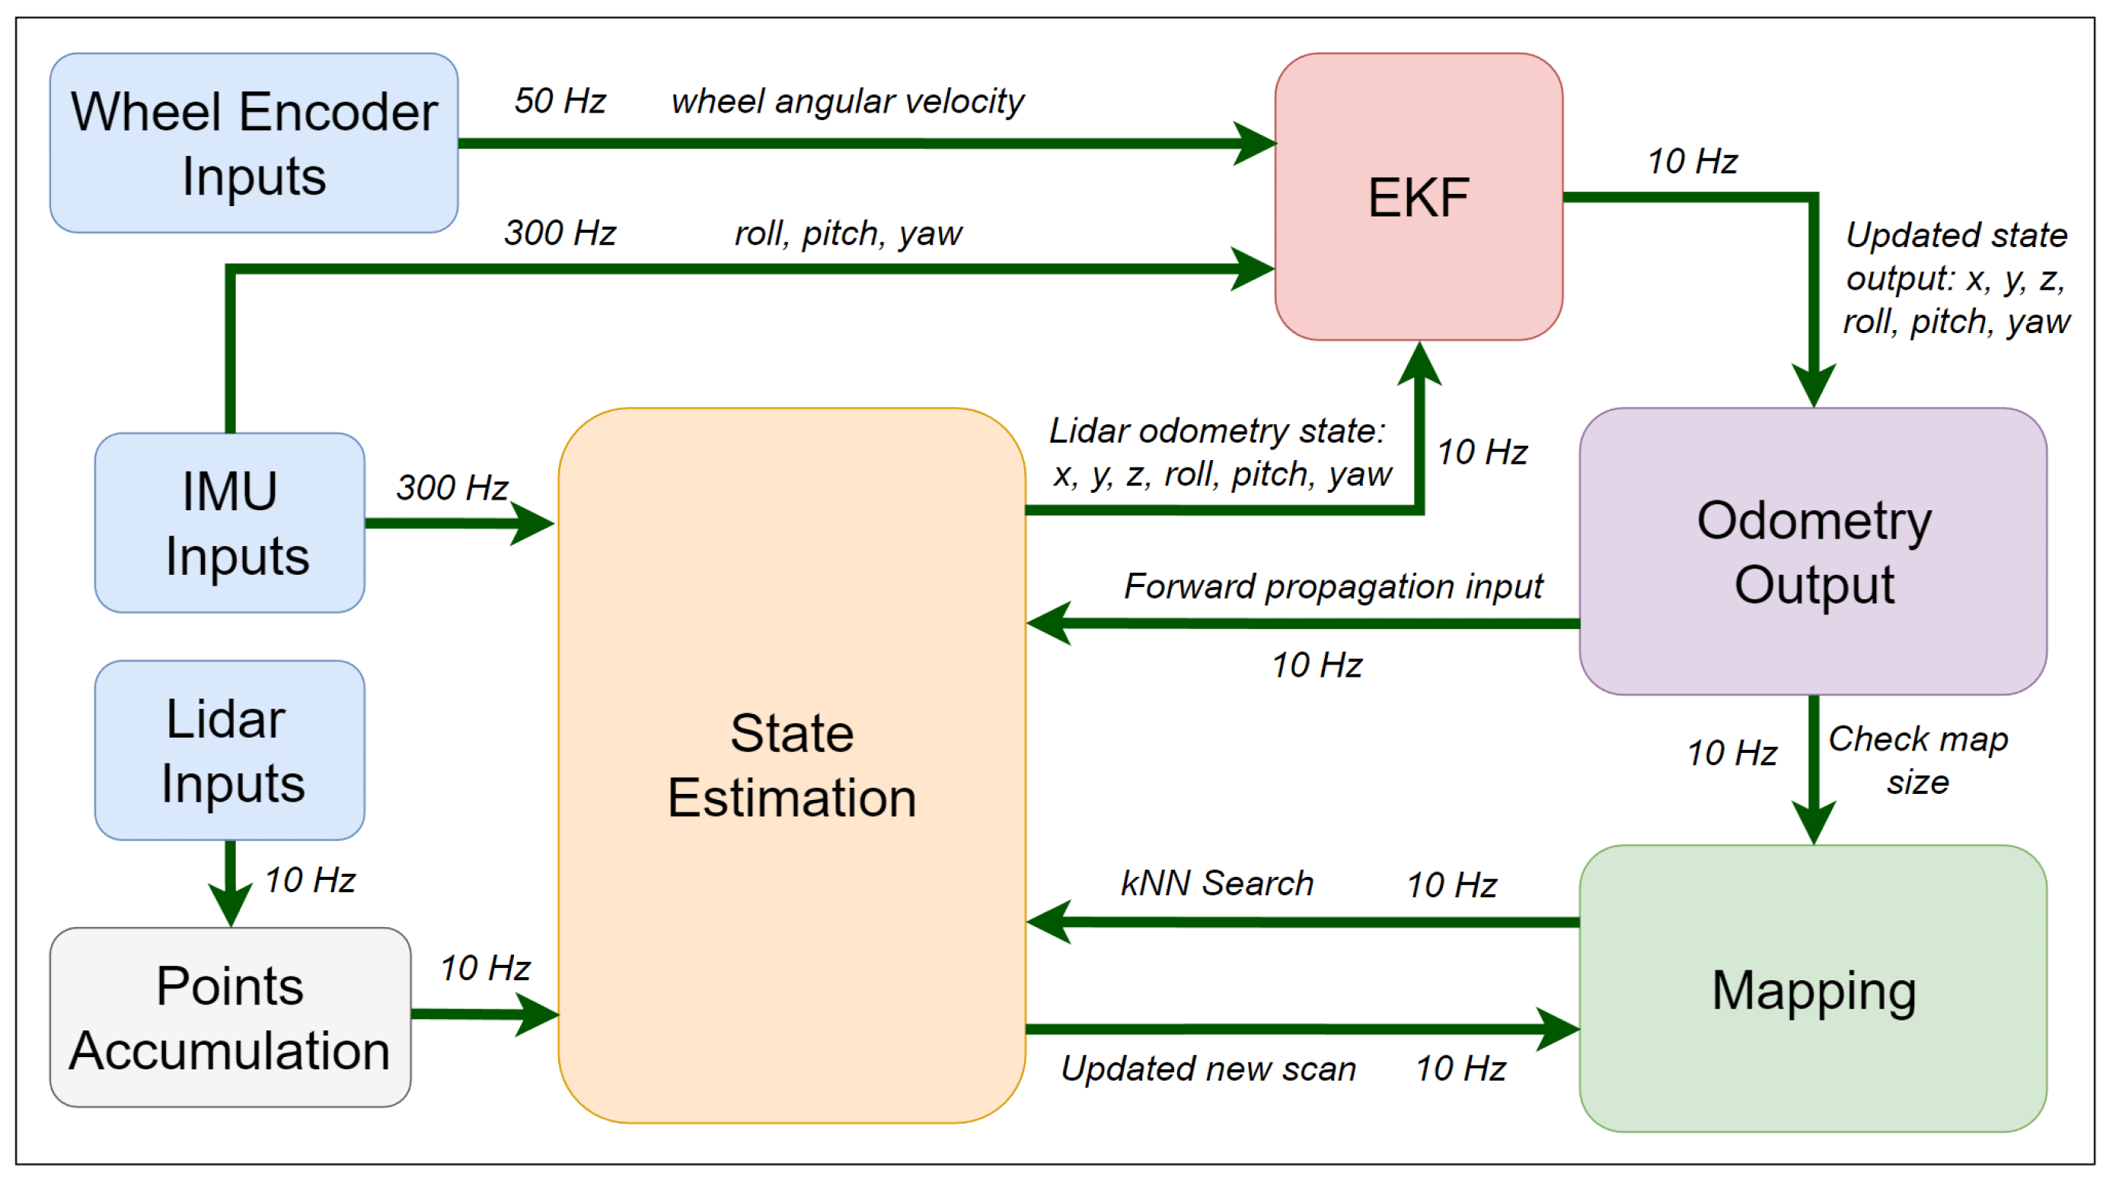
Encoders
Sensor Fusion
LiDAR SLAM with a Wheel Encoder in a Featureless Tunnel Environment
EKF synchronize frequency
Advantage :
- combine IMU, Encoders, LiDAR using extended Kalman Filter
Limitation :
- the algorithm is only validated in flat and inclined terrian
Notes:
Encoder signal frequency is different.
EKF to ensure the frequency of the combined singal from IMU and encoders are synchronized
/delete

Slide 29
Thank you
Notes:
Group papers in one slide ( 2nd slide )
One example in depth, not all
Reduce text , remove figure capation
Reference (in content+year, end reference)
Each slide 20-30 s
Not detailed in one paper
Talk slow
Numbering papers, slides
Icon on top (title, subtitle)
Pop up (animation)
Time limit (10min)
First slides (categories/abstract information)

